Slide 1
HTTP EXAMPLE 1

Slide 2
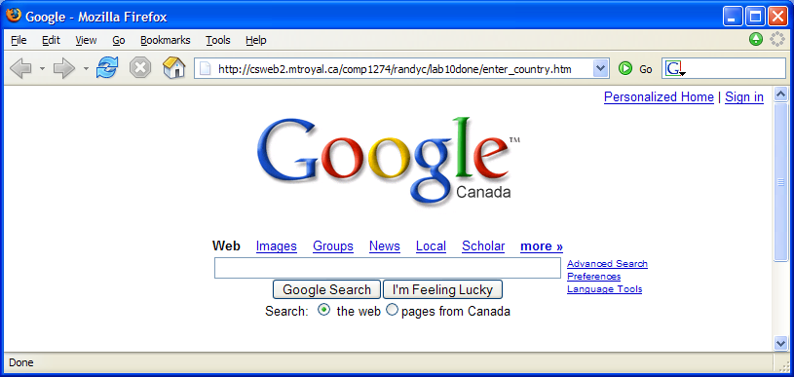
1. User makes request

Slide 3
2. Browser sends HTTP request to server
GET /comp1274/randyc/lab10done/enter_country.htm HTTP/1.1
Accept: */*
Accept-Language: en-us,en-ca;q=0.5
Accept-Encoding: gzip, deflate
User-Agent: Mozilla/4.0 (compatible; MSIE 6.0; Windows NT 5.1; SV1; .NET CLR 1.1.4322; InfoPath.1; .NET CLR 2.0.50727)
Host: csweb2.mtroyal.ca
Connection: Keep-Alive
http://en.wikipedia.org/wiki/HTTP_persistent_connection
Sử dụng cùng một TCP connection
cho nhiều HTTP request
HTTP
Request
Browser
Web Server

Slide 4
3. Server receives and processes the HTTP request
HTTP
Request
Browser
Web Server
Retrieve
Requested file

Slide 5
4. Server sends HTTP response back
HTTP/1.1 200 OK
Server: Microsoft-IIS/5.0
Date: Thu, 30 Mar 2006 19:50:54 GMT
Content-Type: text/html
Accept-Ranges: bytes
Last-Modified: Fri, 24 Mar 2006 17:50:50 GMT
Content-Length: 209
<HTML><HEAD><TITLE>Enter A Country</TITLE></HEAD>
<BODY>
<FORM METHOD=POST ACTION=form_filter.asp>
Enter Country Search:
<INPUT TYPE=TEXT NAME=Search><P>
<INPUT TYPE=SUBMIT>
</FORM>
</BODY></HTML>
Server
HTTP
Response
Browser

Slide 6
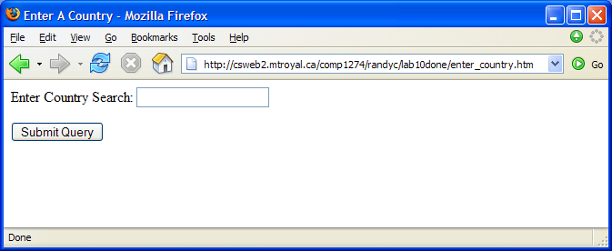
5. Browser displays response

Slide 7
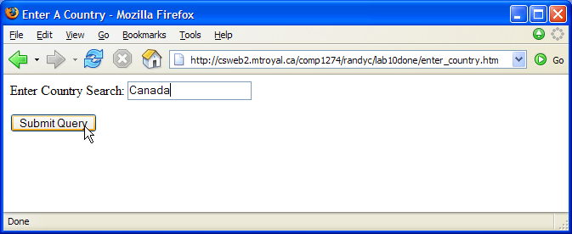
6. User submits data

Slide 8
7. Browser sends HTTP request to server
POST /comp1274/randyc/lab10done/form_filter.asp HTTP/1.1
Accept: */*
Referer: http://csweb2.mtroyal.ca/comp1274/randyc/lab10done/enter_country.htm
Accept-Language: en-us,en-ca;q=0.5
Content-Type: application/x-www-form-urlencoded
Accept-Encoding: gzip, deflate
User-Agent: Mozilla/4.0 (compatible; MSIE 6.0; Windows NT 5.1; SV1; .NET CLR 1.1.4322; InfoPath.1; .NET CLR 2.0.50727)
Host: csweb2.mtroyal.ca
Content-Length: 13
Connection: Keep-Alive
Cache-Control: no-cache
Search=Canada
User entered form data goes here in the http request header
as a name=value pair

Slide 9
Digression: What if GET rather than POST?
<FORM METHOD=GET ACTION=form_filter.asp>
Then the user entered form data is added to the requested URL
GET /comp1274/randyc/lab10done/form_filter.asp?Search=Canada HTTP/1.1
Versus
<FORM METHOD=POST ACTION=form_filter.asp>
Then the user entered form data is added to the end of HTTP request header
POST /comp1274/randyc/lab10done/form_filter.asp HTTP/1.1
rest of HTTP request header goes here
Search=Canada

Slide 10
8. Server receives and processes the HTTP request
HTTP
Request
Browser
Web Server
Server processes
the request

Slide 11
9. Server script generates response sent back to browser
HTTP/1.1 200 OK
Server: Microsoft-IIS/5.0
Date: Thu, 30 Mar 2006 19:51:06 GMT
Content-Length: 164
Content-Type: text/html
Cache-control: private
<HTML><HEAD><TITLE>Reading Recordsets</TITLE></HEAD>
<BODY>
<H2>Countries</H2>
<TABLE BORDER=1>
<TR><TD>2</TD><TD>Canada</TD></TR>
</TABLE>
</BODY></HTML>

Slide 12
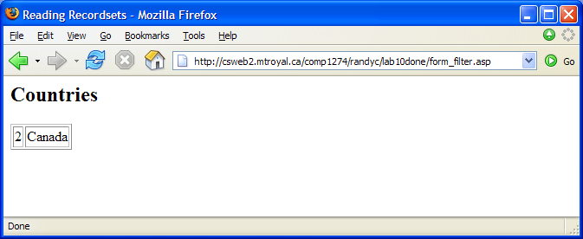
10. Browser displays the response

Slide 13
HTTP EXAMPLE 2

Slide 14
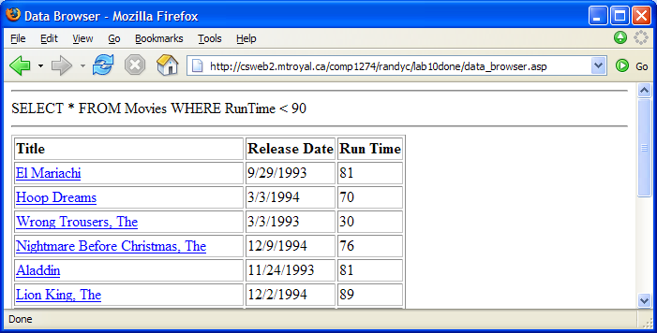
1. User makes request

Slide 15
2. Browser sends HTTP request to server
GET /comp1274/randyc/lab10done/data_browser.asp HTTP/1.1
Accept: */*
Accept-Language: en-us,en-ca;q=0.5
Accept-Encoding: gzip, deflate
User-Agent: Mozilla/4.0 (compatible; MSIE 6.0; Windows NT 5.1; SV1; .NET CLR 1.1.4322; InfoPath.1; .NET CLR 2.0.50727)
Host: csweb2.mtroyal.ca
Connection: Keep-Alive

Slide 16
3. Server receives and processes the HTTP request
HTTP
Request
Browser
Web Server
Server processes
the request

Slide 17
4. Server script generates response sent back to browser
HTTP/1.1 200 OK
Server: Microsoft-IIS/5.0
Date: Thu, 30 Mar 2006 19:51:06 GMT
Content-Length: 1590
Content-Type: text/html
Cache-control: private
<HTML><HEAD><TITLE>Data Browser</TITLE></HEAD>
<BODY>
<HR>SELECT * FROM Movies WHERE RunTime < 90<HR>
<TABLE BORDER=1>
<TR>
<TD><B>Title</B></TD>
<TD><B>Release Date</B></TD>
<TD><B>Run Time</B></TD>
</TR>
...

Slide 18
5. Browser displays the response

Slide 19
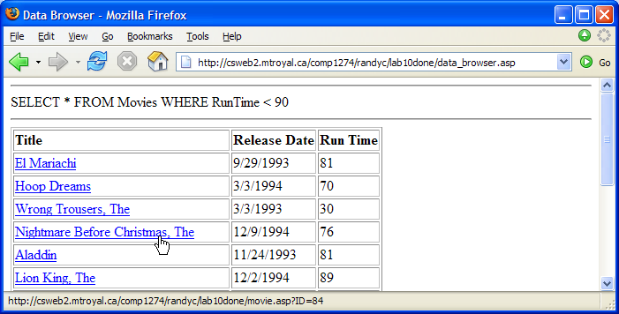
6. User makes request (click on a link)

Slide 20
7. Browser sends HTTP request to server
GET /comp1274/randyc/lab10done/movie.asp?ID=84 HTTP/1.1
Accept: */*
Referer: http://csweb2.mtroyal.ca/comp1274/randyc/lab10done/data_browser.asp
Accept-Language: en-us,en-ca;q=0.5
Accept-Encoding: gzip, deflate
User-Agent: Mozilla/4.0 (compatible; MSIE 6.0; Windows NT 5.1; SV1; .NET CLR 1.1.4322; InfoPath.1; .NET CLR 2.0.50727)
Host: csweb2.mtroyal.ca
Connection: Keep-Alive

Slide 21
8. Server receives request, processes it, and generates response
HTTP/1.1 200 OK
Server: Microsoft-IIS/5.0
Date: Thu, 30 Mar 2006 19:51:06 GMT
Content-Length: 585
Content-Type: text/html
Cache-control: private
<HTML><HEAD><TITLE>Nightmare Before Christmas, The</TITLE></HEAD>
<BODY>
<H1>Nightmare Before Christmas, The</H1>
Directed by <B>Henry Selick</B><BR>
Released on 12/9/1994<BR>
Movie length is 76 minutes
<H2>Summary</H2>
...

Slide 22
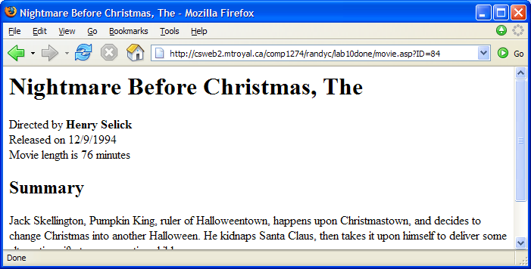
9. Browser displays the response

Slide 23
HTTP EXAMPLE 3

Slide 24
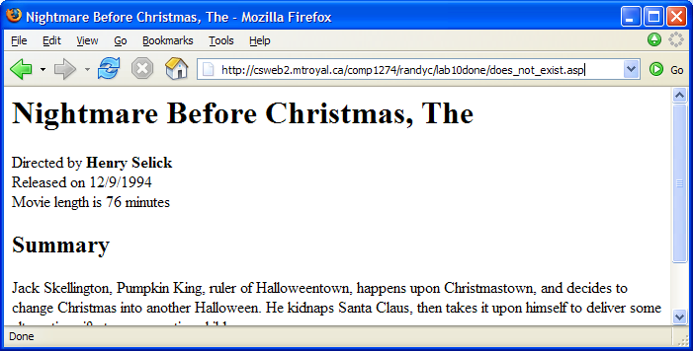
1. User makes request

Slide 25
2. Browser sends HTTP request to server
GET /comp1274/randyc/lab10done/does_not_exist.asp HTTP/1.1
Accept: */*
Accept-Language: en-us,en-ca;q=0.5
Accept-Encoding: gzip, deflate
User-Agent: Mozilla/4.0 (compatible; MSIE 6.0; Windows NT 5.1; SV1; .NET CLR 1.1.4322; InfoPath.1; .NET CLR 2.0.50727)
Host: csweb2.mtroyal.ca
Connection: Keep-Alive

Slide 26
3. Server receives and processes the HTTP request
HTTP
Request
Browser
Web Server
Server processes
the request

Slide 27
4. Server receives request, processes it, and generates response
HTTP/1.1 404 Object Not Found
Server: Microsoft-IIS/5.0
Date: Thu, 30 Mar 2006 19:51:06 GMT
Content-Length: 4040
Content-Type: text/html
Cache-control: private
<html>
...
<title>The page cannot be found</title>
...
<body>
<table>
...
The page you are looking for might have been removed, had its
...

Slide 28
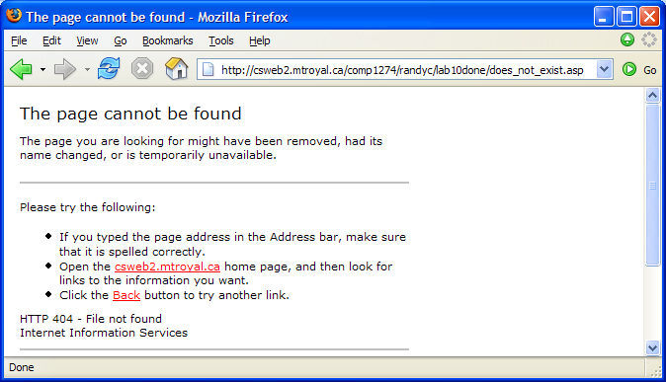
5. Browser displays the response

